Slide 1

Think of Investing in Dubai
Mohamed Idris A. Maricar
A Data Engineering Project - WeCloudData

Slide 2

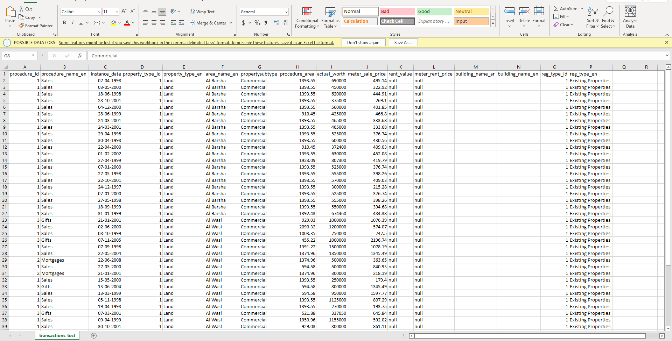
Dubai Land Department Data – Open-source data available on DubaiPulse website

Slide 3



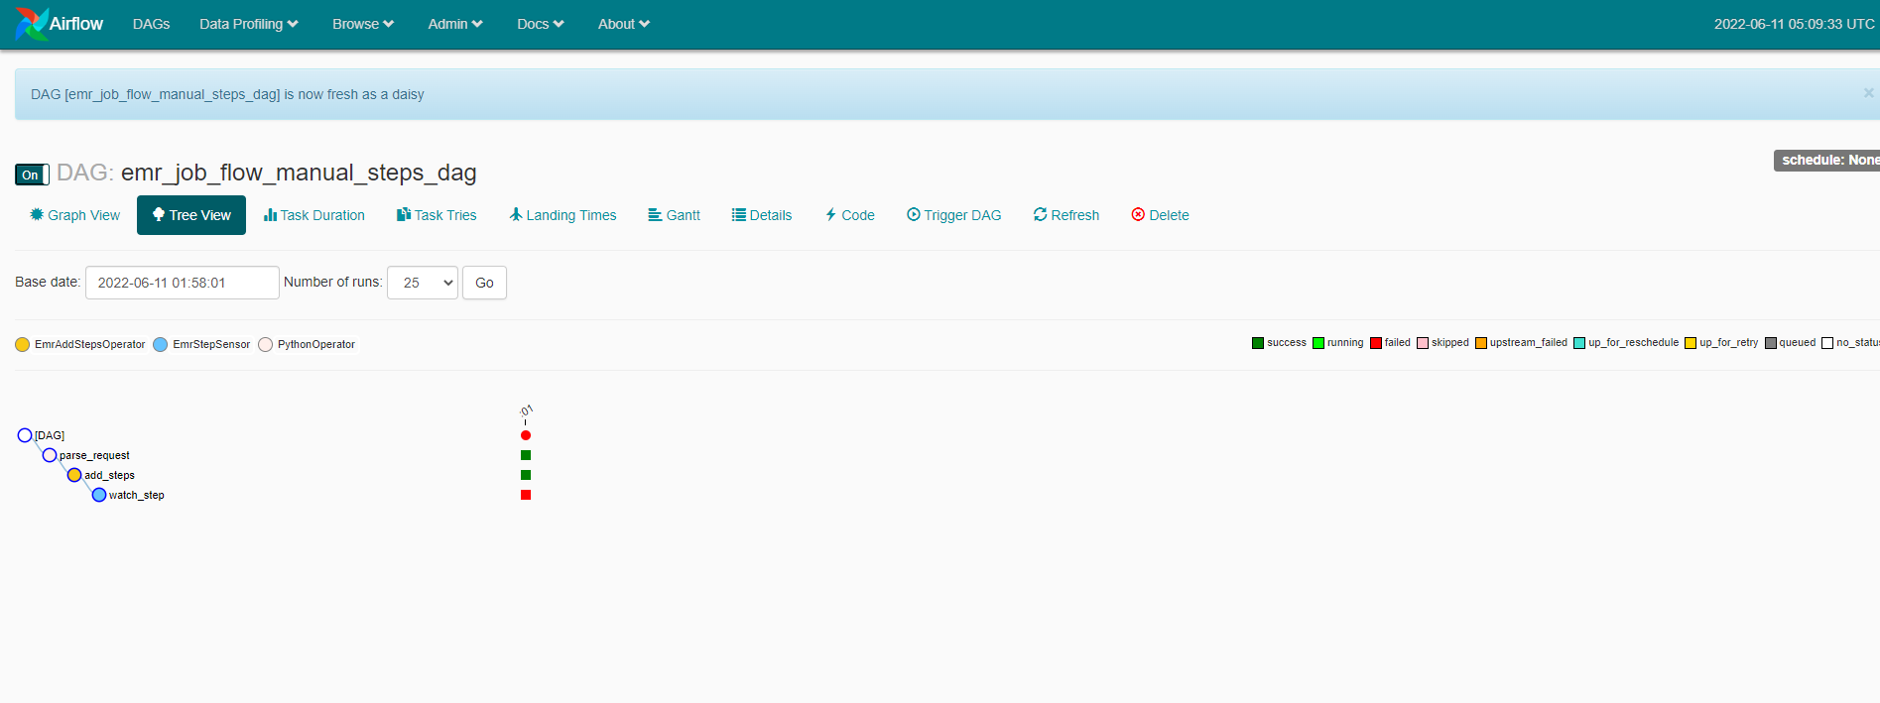






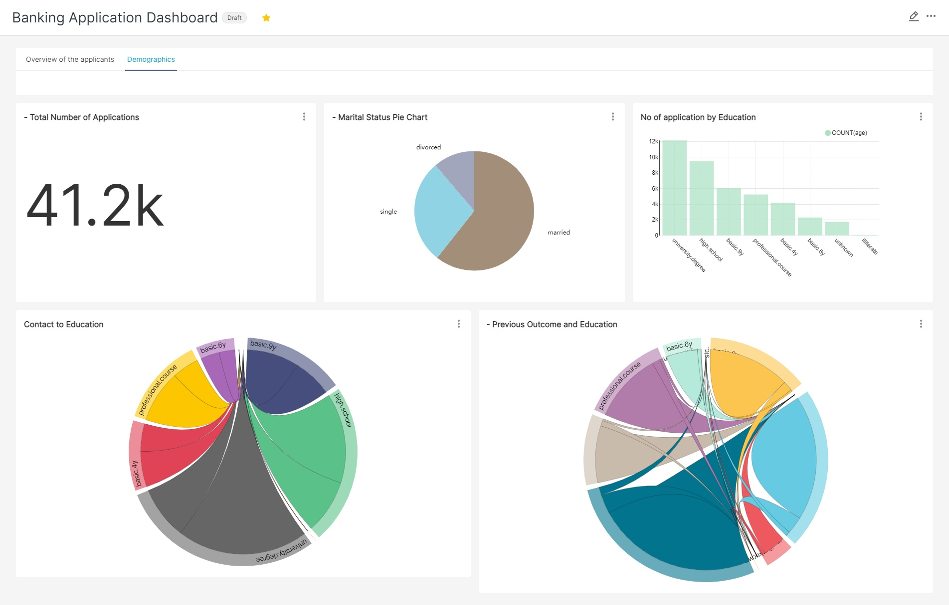
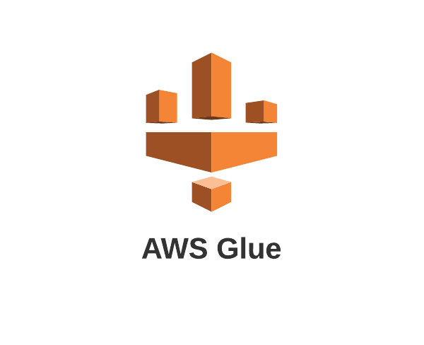


Project Architecture
Docker on EC2

Slide 4
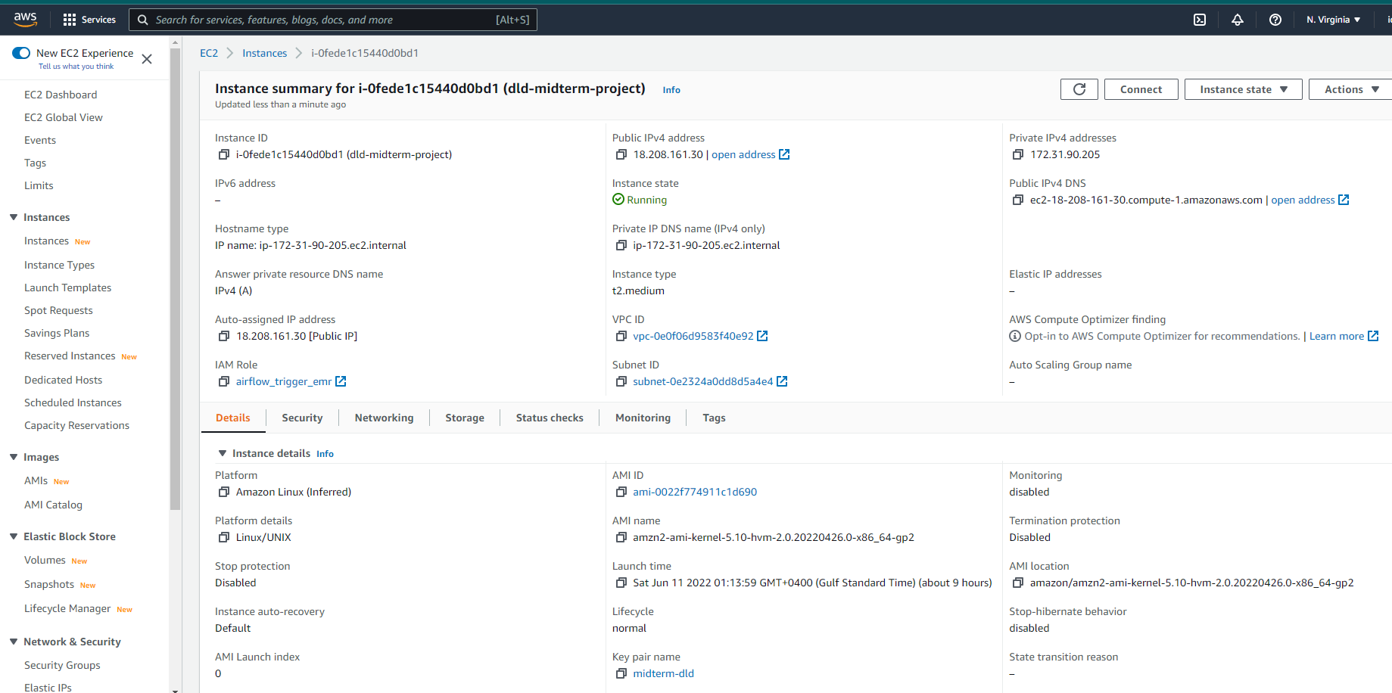
AWS EC2 instance for Airflow and Superset

Slide 5
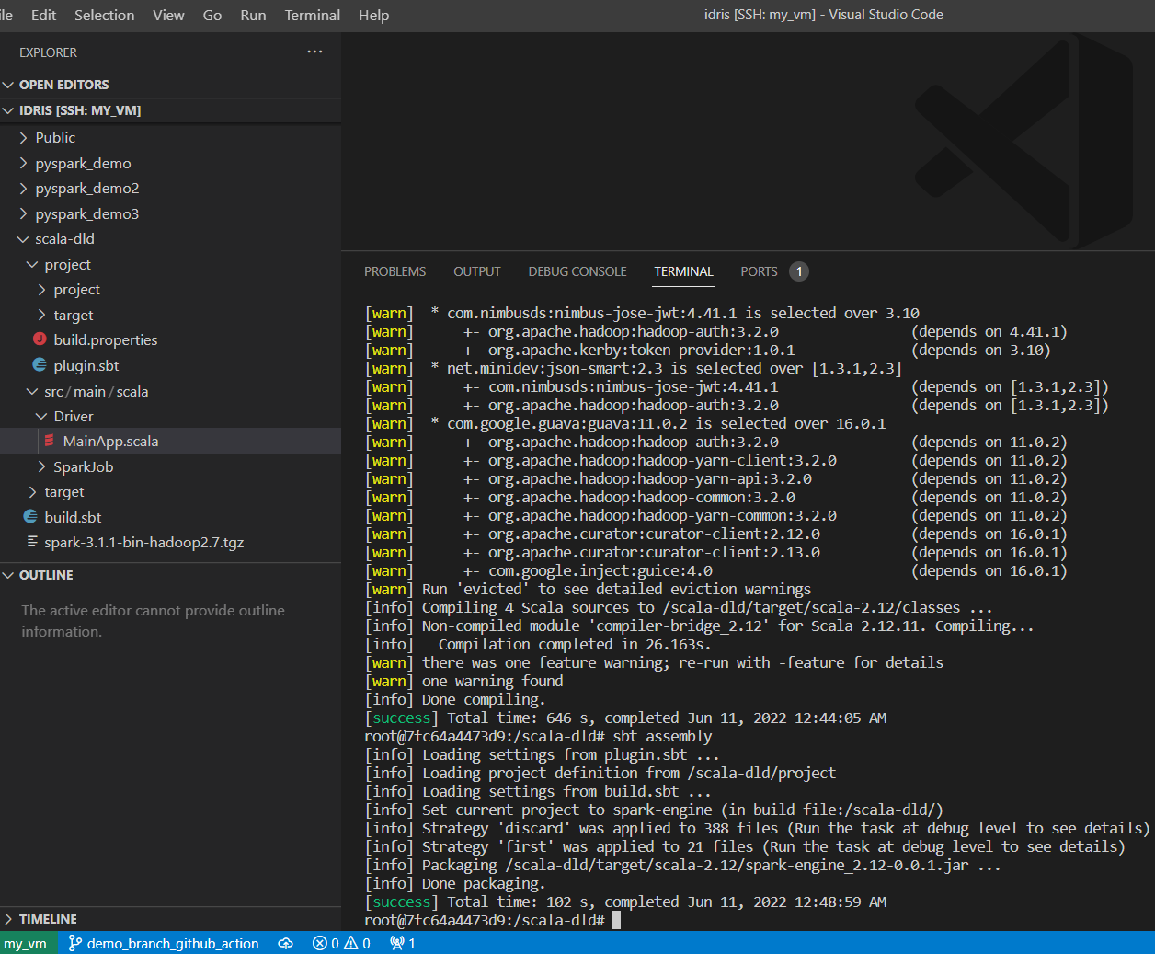
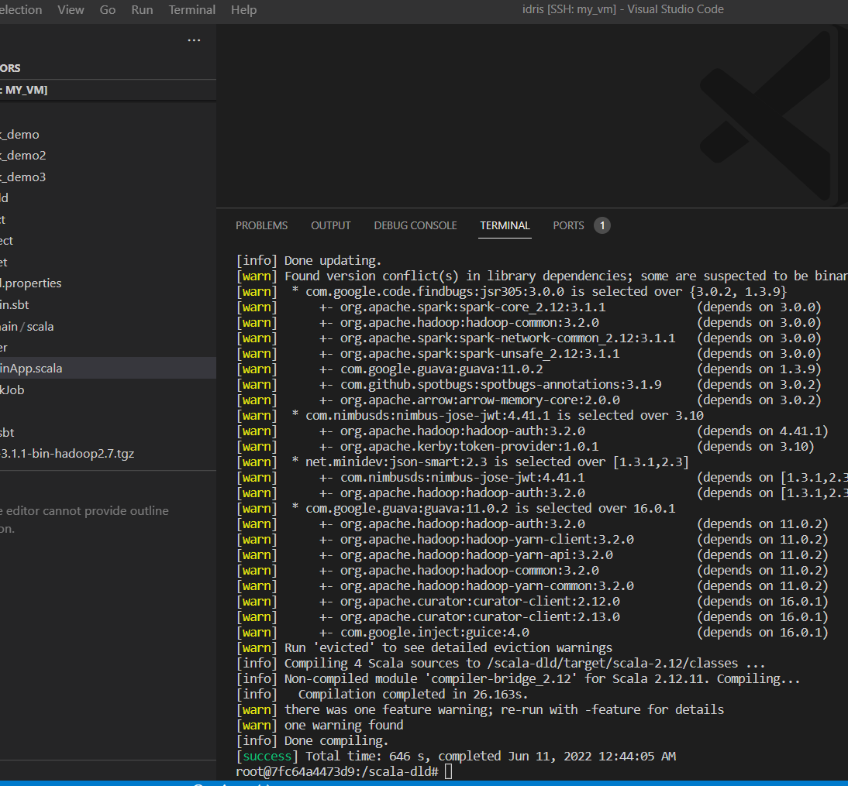
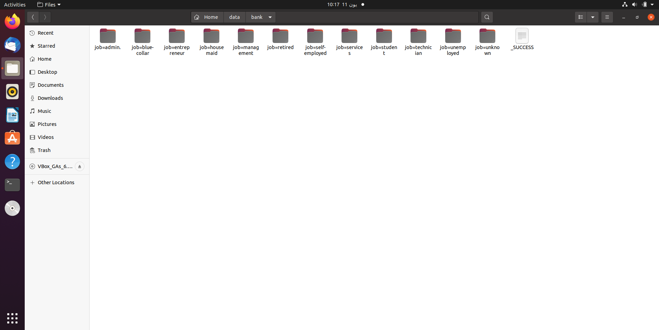
Writing Code and Testing it on VM
Prepare the scala files as per Edwin’s project
Run sbt docker linking local files to docker
Run sbt compile to compile Scala code for the project
Run sbt assembly to get the jar file
Now download and unzip Spark 3.1.3 file.
Access the Spark-3.1.3-bin-hadoop3.2 folder and run the spark submit command locating the csv file and assigning the column for partition

Slide 6
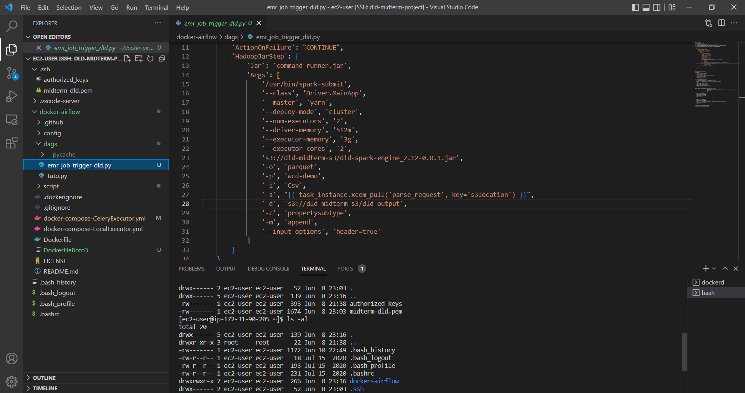
Preparing the Dag for Airflow

Slide 7
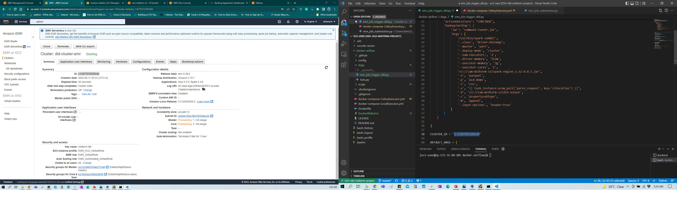
Getting the AWS EMR cluster ready to run the spark job.

Slide 8
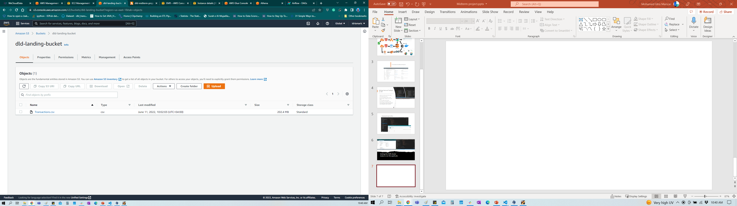
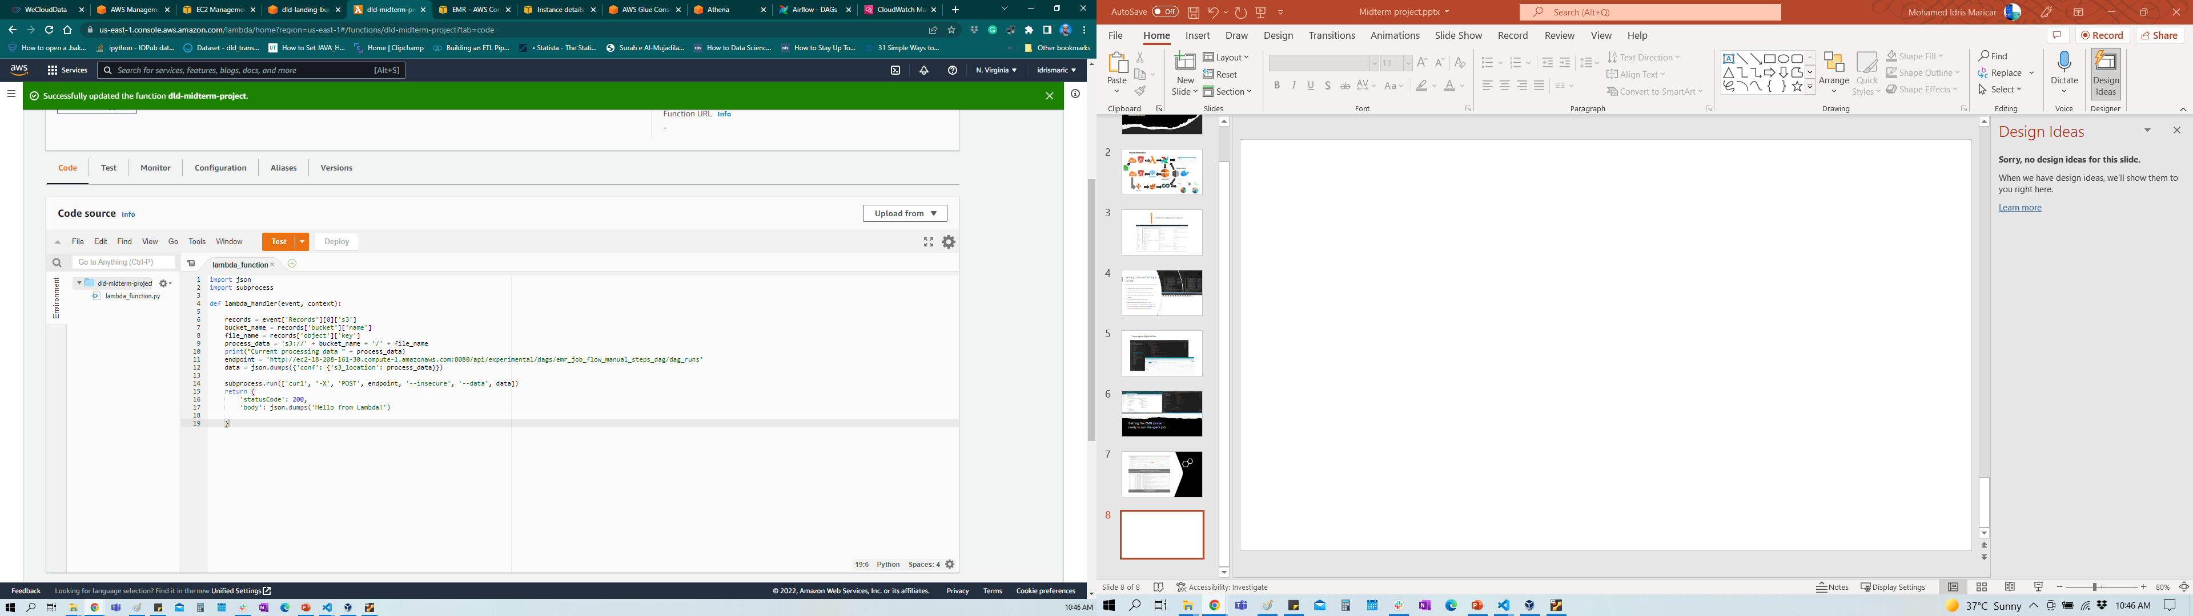
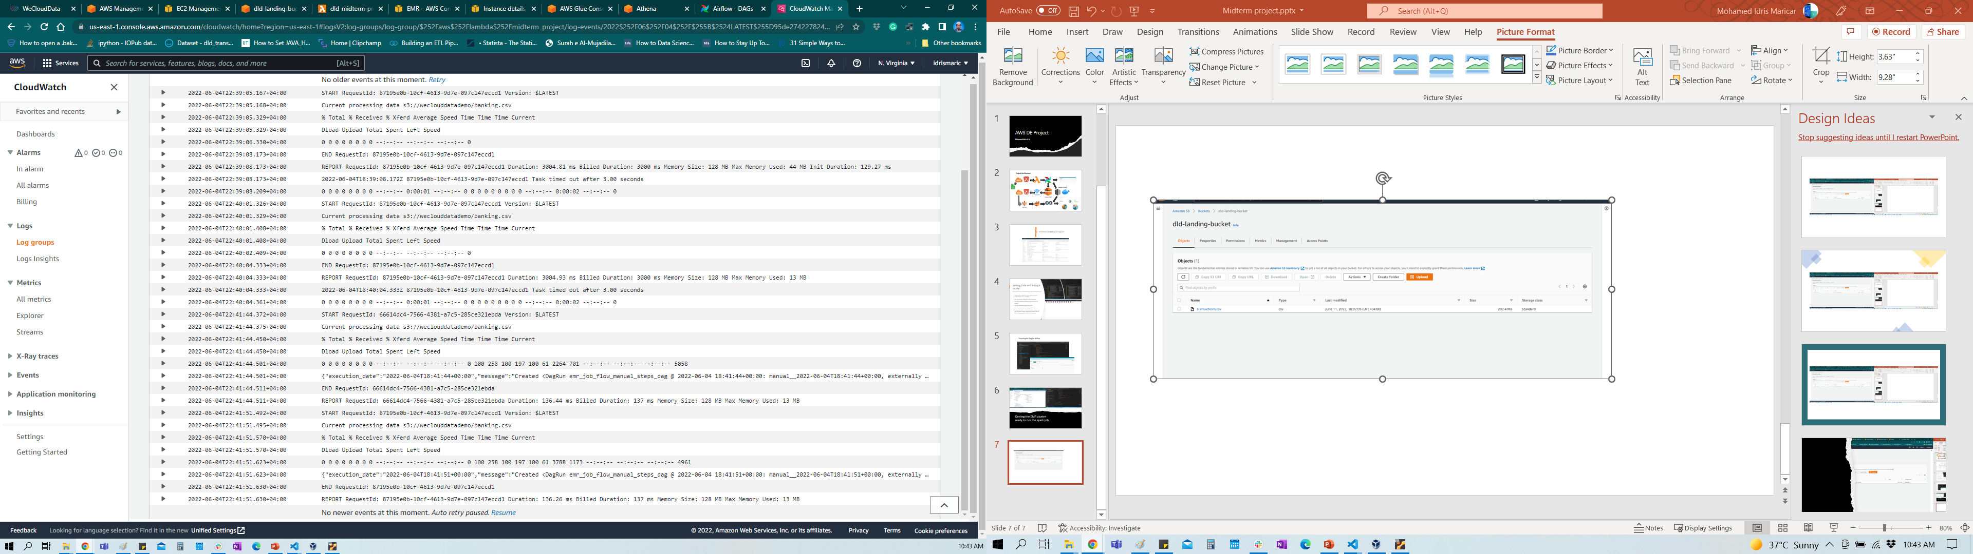
Uploading csv file on to landing S3 bucket
Using lambda function to process file landed on S3 bucket
Monitoring lambda process
in Cloudwatch

Slide 9
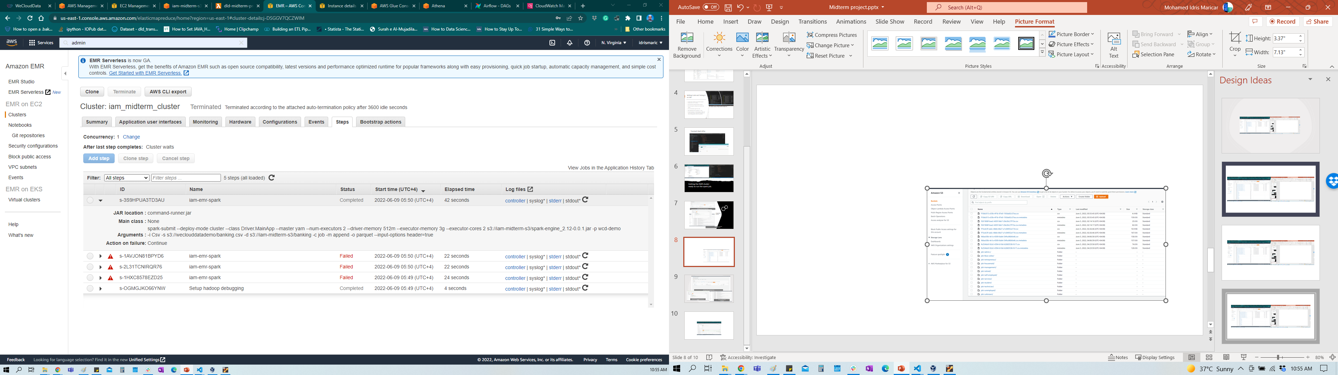
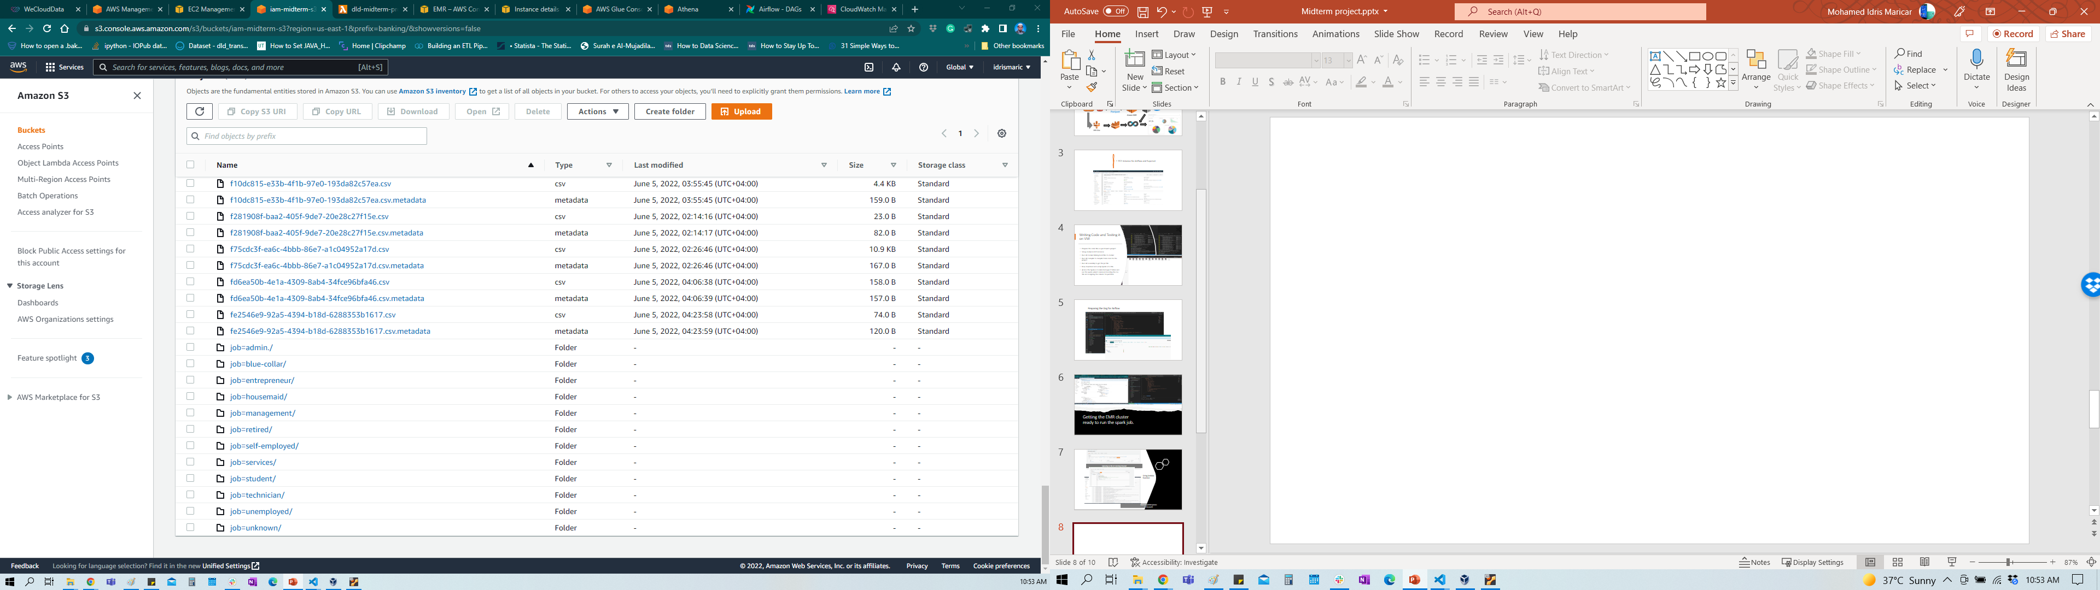
EMR Cluster run successfully and produced output files in output folder

Slide 10
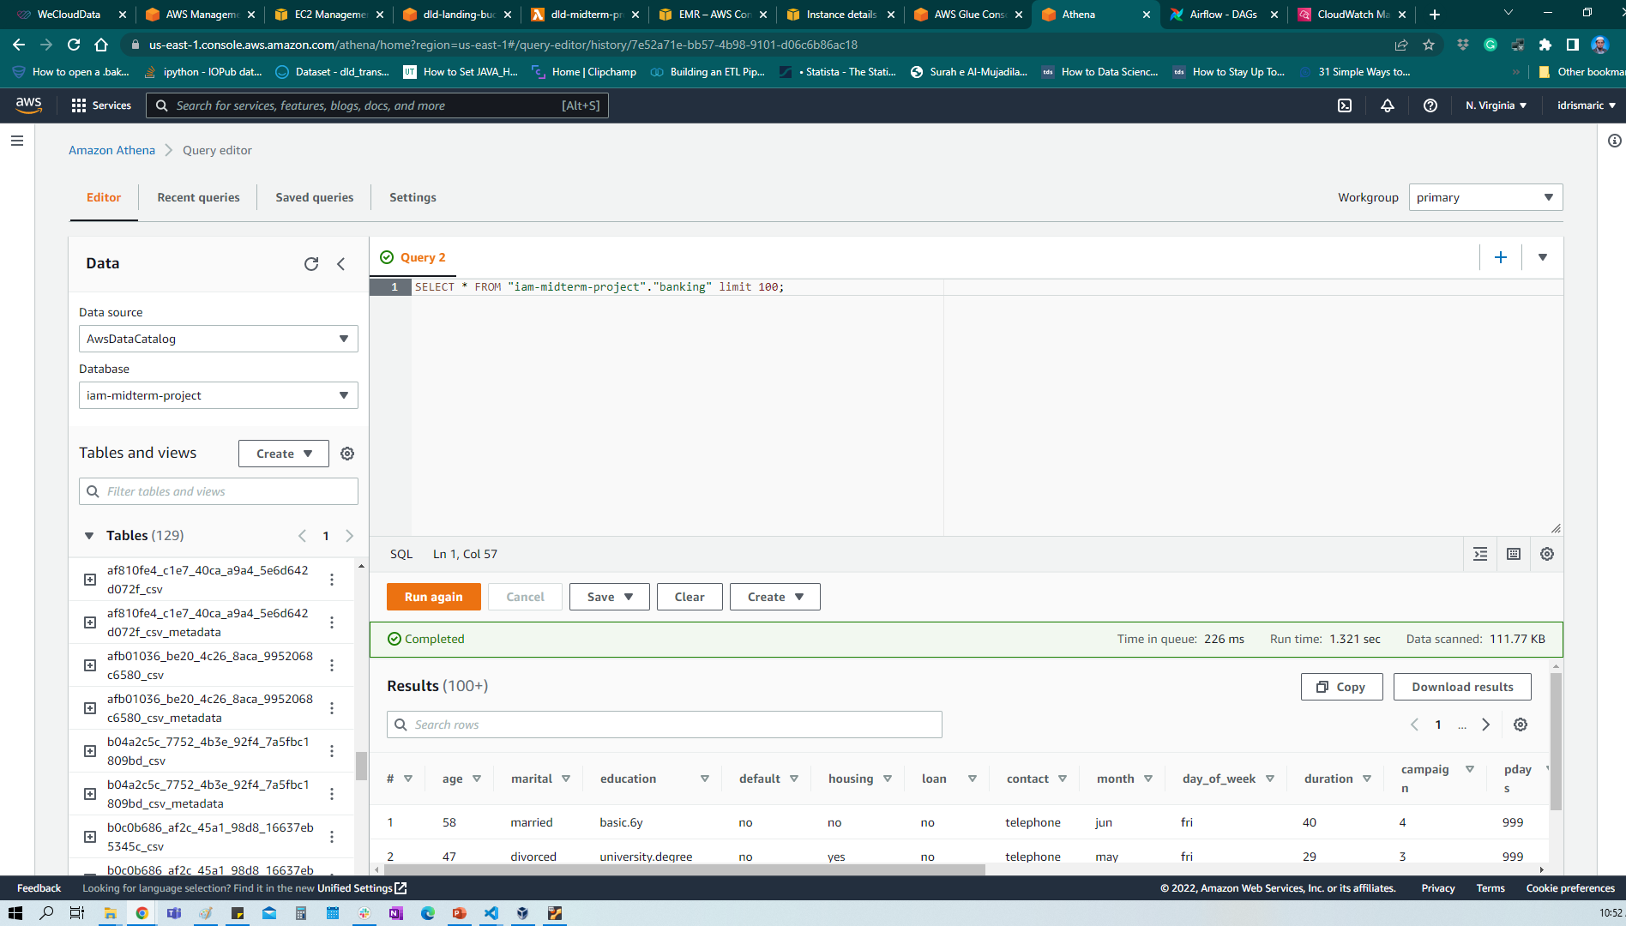
Setup Athena and run queries on Tables
Connect Superset running on Docker to Athena

Slide 11
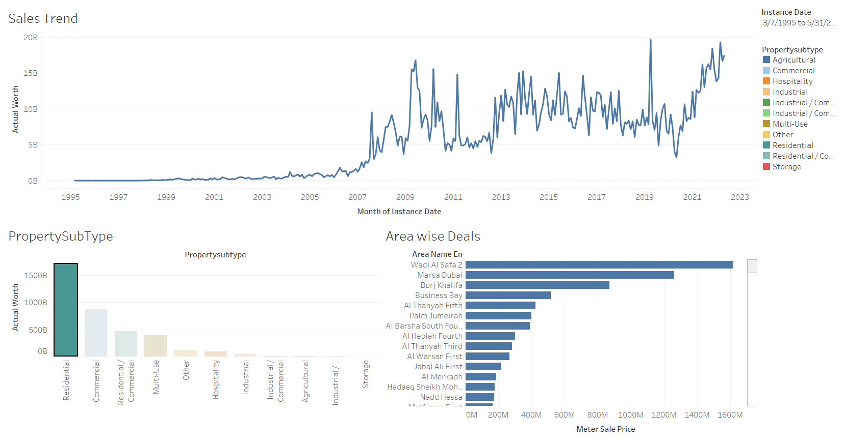
Think of investing in Dubai

Slide 12
Plan for the Final Project
To successfully run the Dubai Real Estate live data on this pipeline
To visualize the property types sold on a daily basis
To do further analysis on the dataset
Automate the process of data input to landing bucket
Use Elastic IP or other solutions to not repeat the process of changing IP for connection to Airflow
All other changes to be done automatically like EMR cluster ID, External IP address of EC2 to be automatically changed in Lambda code
To incorporate predictive modeling (Data Science) onto the automated data to predict trends

Slide 13
Thank You

